Slide 1
Notifications

Slide 2
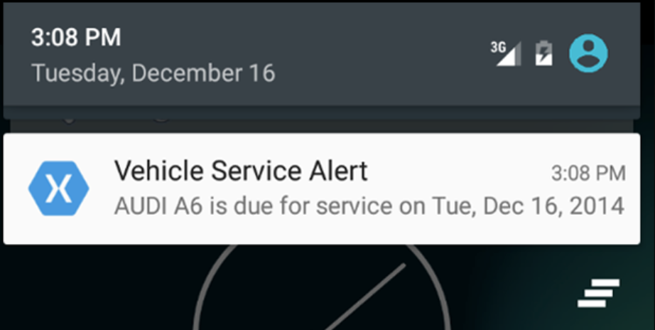
Notifications Overview
A notification is a message that Android displays outside your app's UI to provide the user with reminders, communication from other people, or other timely information from your app. Users can tap the notification to open your app or take an action directly from the notification.

Slide 3
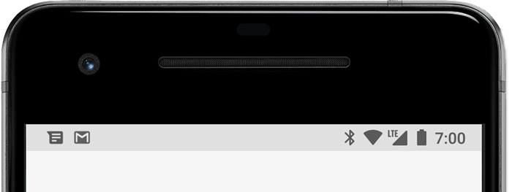
Appearances on a device
Notifications appear to users in different locations and formats, such as an icon in the status bar, a more detailed entry in the notification drawer, as a badge on the app's icon, and on paired wearables automatically.
Status bar and notification drawer
When you issue a notification, it first appears as an icon in the status bar.
Notification icons appear on the left side of the status bar

Slide 4
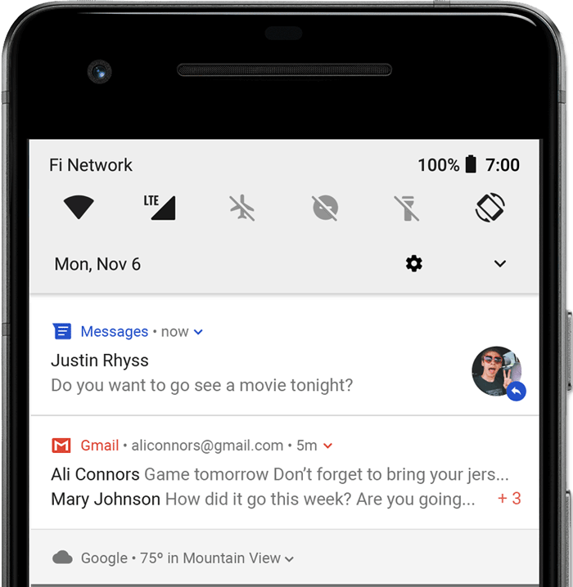
Users can swipe down on the status bar to open the notification drawer, where they can view more details and take actions with the notification.
Users can drag down on a notification in the drawer to reveal the expanded view, which shows additional content and action buttons, if provided.
A notification remains visible in the notification drawer until dismissed by the app or the user.
Notifications in the notification drawer

Slide 5
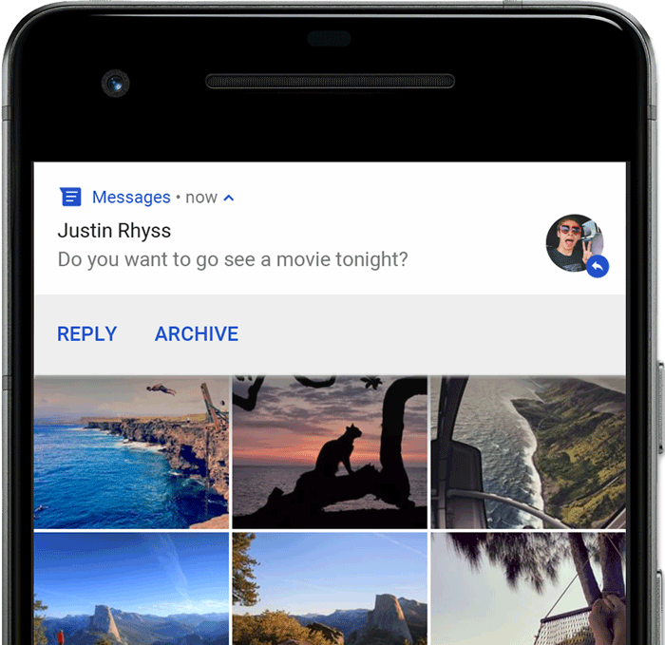
Heads-up notification
Beginning with Android 5.0, notifications can briefly appear in a floating window called a heads-up notification. This behavior is normally for important notifications that the user should know about immediately, and it appears only if the device is unlocked.
The heads-up notification appears the moment your app issues the notification and it disappears after a moment, but remains visible in the notification drawer as usual.
Example conditions that might trigger heads-up notifications include the following:
The user's activity is in fullscreen mode (the app uses fullScreenIntent).
The notification has high priority and uses ringtones or vibrations on devices running Android 7.1 (API level 25) and lower.
The notification channel has high importance on devices running Android 8.0 (API level 26) and higher
A heads-up notification appears in front of the foreground app

Slide 6
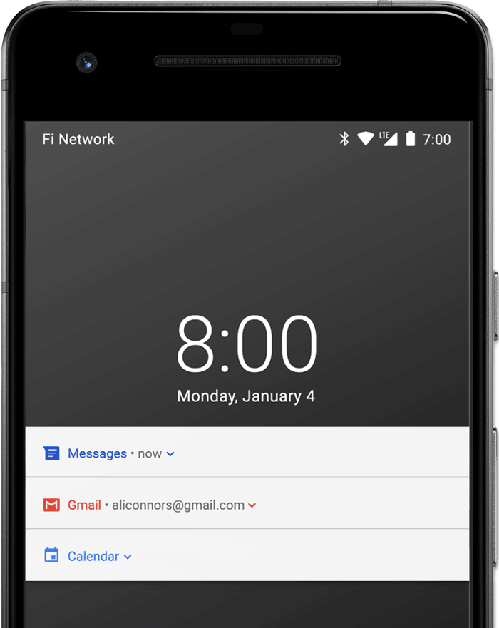
Lock screen
Beginning with Android 5.0, notifications can appear on the lock screen.
You can programmatically set the level of detail visible in notifications posted by your app on a secure lock screen, or even whether the notification will show on the lock screen at all.
Users can use the system settings to choose the level of detail visible in lock screen notifications, including the option to disable all lock screen notifications. Starting with Android 8.0, users can choose to disable or enable lock screen notifications for each notification channel.
Notifications on the lock screen with sensitive content hidden

Slide 7
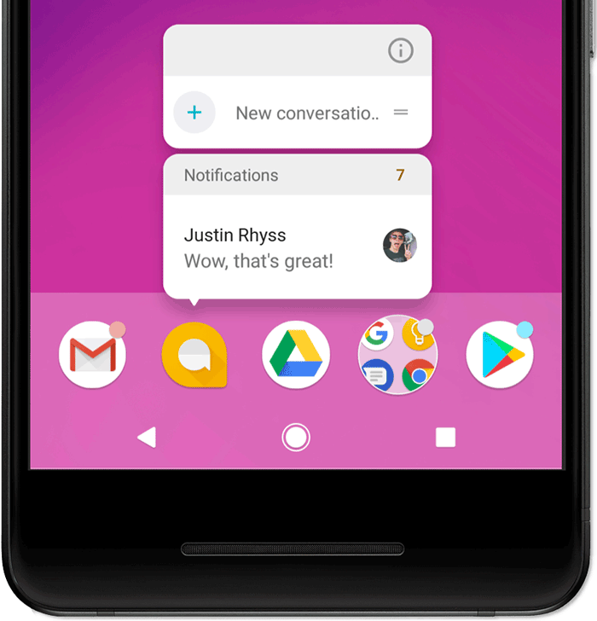
App icon badge
In supported launchers on devices running Android 8.0 (API level 26) and higher, app icons indicate new notifications with a colored "badge" (also known as a "notification dot") on the corresponding app launcher icon.
Users can long-press on an app icon to see the notifications for that app. Users can then dismiss or act on notifications from that menu, similar to the notification drawer.
Notification badges and the long-press menu

Slide 8
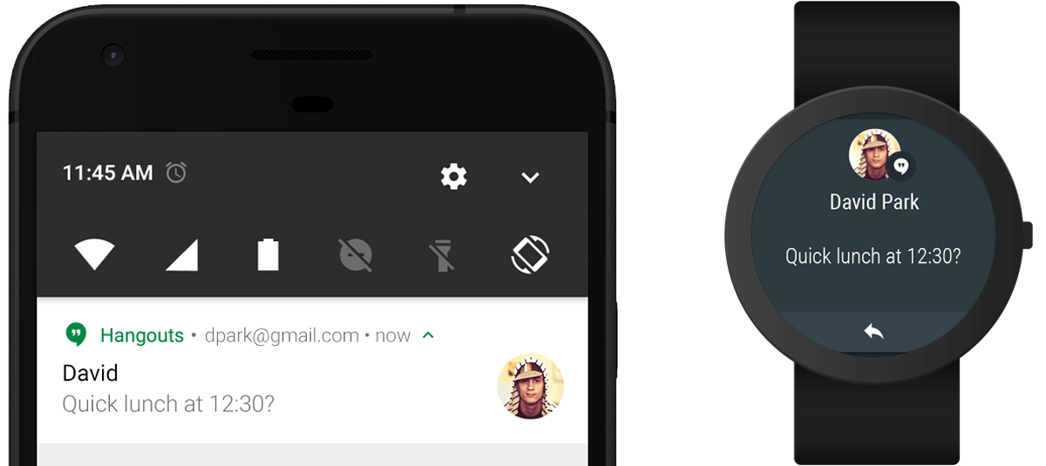
Wear OS devices
If the user has a paired Wear OS device, all your notifications appear there automatically, including expandable detail and action buttons.
You can also enhance the experience by customizing some appearances for the notification on wearables and provide different actions, including suggested replies and voice input replies.
Notifications automatically appear on a paired Wear OS device

Slide 9
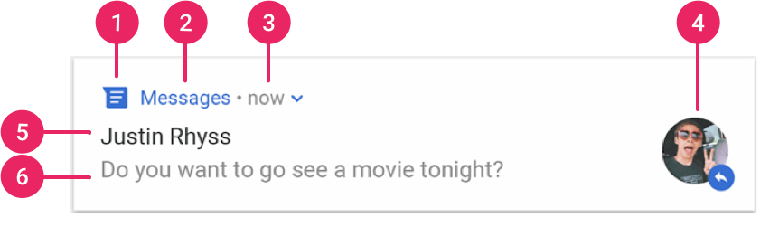
A notification with basic details
The most common parts of a notification are indicated in figure 7 as follows:
Small icon: This is required and set with setSmallIcon().
App name: This is provided by the system.
Time stamp: This is provided by the system but you can override with setWhen() or hide it with setShowWhen(false).
Large icon: This is optional (usually used only for contact photos; do not use it for your app icon) and set withsetLargeIcon().
Title: This is optional and set with setContentTitle().
Text: This is optional and set with setContentText().

Slide 10
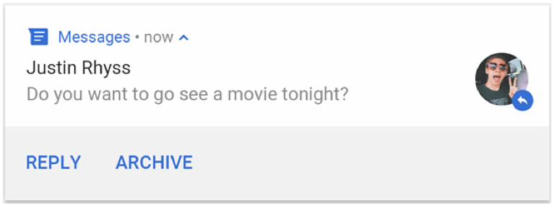
Notification actions
Although it's not required, every notification should open an appropriate app activity when tapped. In addition to this default notification action, you can add action buttons that complete an app-related task from the notification (often without opening an activity)
Starting in Android 7.0 (API level 24), you can also add an action to reply to messages or enter other text directly from the notification.

Slide 11
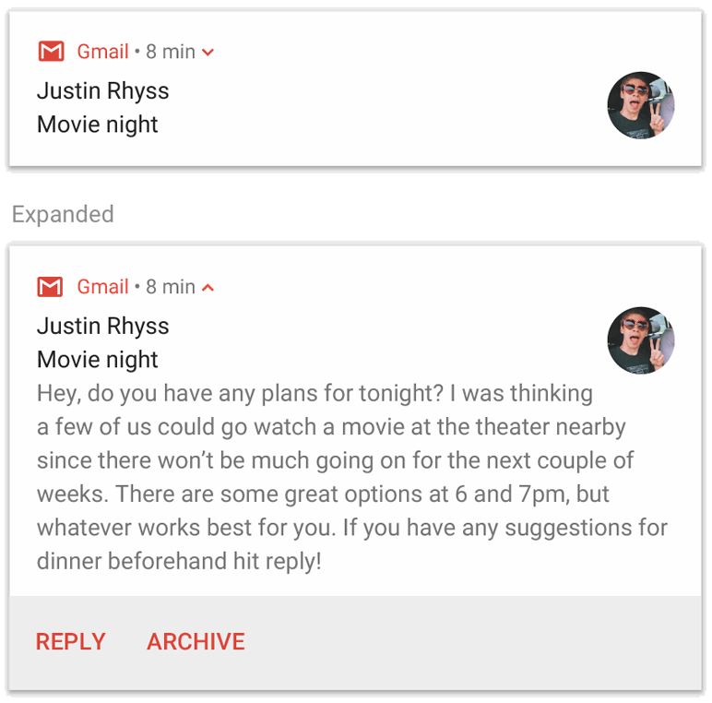
Expandable notification
By default, the notification's text content is truncated to fit on one line. If you want your notification to be longer, you can enable a larger text area that's expandable by applying an additional template, as shown

Slide 12
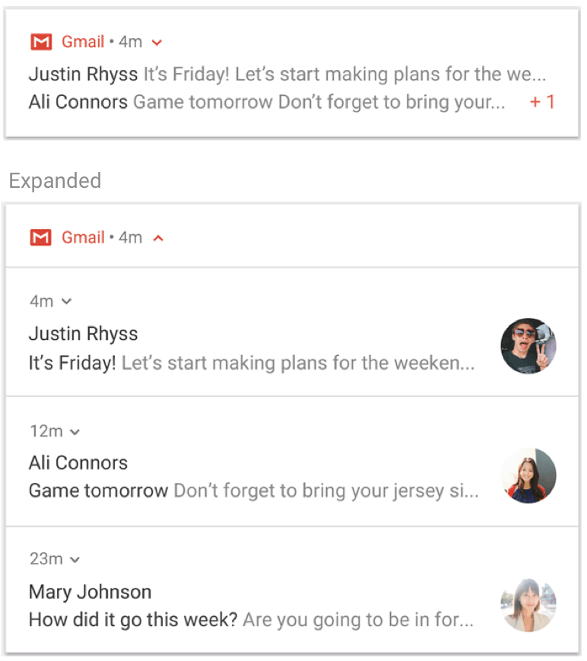
Notification updates and groups
To avoid bombarding your users with multiple or redundant notifications when you have additional updates, you should consider updating an existing notification rather than issuing a new one, or consider using the inbox-style notification to show conversation updates.
However, if it's necessary to deliver multiple notifications, you should consider grouping those separate notifications into a group (available on Android 7.0 and higher). A notification group allows you to collapse multiple notifications into just one post in the notification drawer, with a summary. The user can then expand the notification to reveal the details for each individual notification.
The user can progressively expand the notification group and each notification within it for more details.
A collapsed and expanded notification group

Slide 13
Notification channels
Starting in Android 8.0 (API level 26), all notifications must be assigned to a channel or it will not appear. By categorizing notifications into channels, users can disable specific notification channels for your app (instead of disabling all your notifications), and users can control the visual and auditory options for each channel—all from the Android system settings. Users can also long-press a notification to change behaviors for the associated channel.
On devices running Android 7.1 (API level 25) and lower, users can manage notifications on a per-app basis only (effectively each app only has one channel on Android 7.1 and lower).

Slide 14
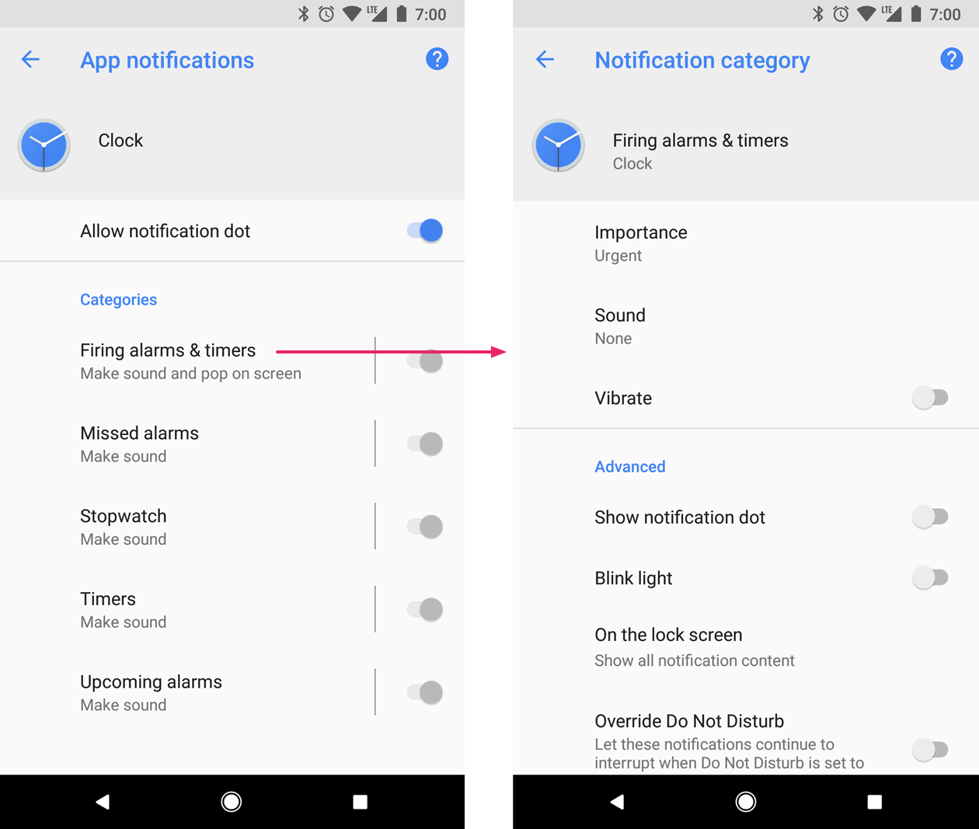
One app can have multiple notification channels - a separate channel for each type of notification the app issues. An app can also create notification channels in response to choices made by users of your app. For example, you may set up separate notification channels for each conversation group created by a user in a messaging app.
The channel is also where you specify the importance level for your notifications on Android 8.0 and higher. So all notifications posted to the same notification channel have the same behavior.
Notification settings for Clock app and one of its channels

Slide 15
Notification importance
Android uses the importance of a notification to determine how much the notification should interrupt the user (visually and audibly). The higher the importance of a notification, the more interruptive the notification will be.
On Android 8.0 (API level 26) and above, importance of a notification is determined by the importance of the channel the notification was posted to. Users can change the importance of a notification channel in the system settings (figure 12). On Android 7.1 (API level 25) and below, importance of each notification is determined by the notification's priority.

Slide 16
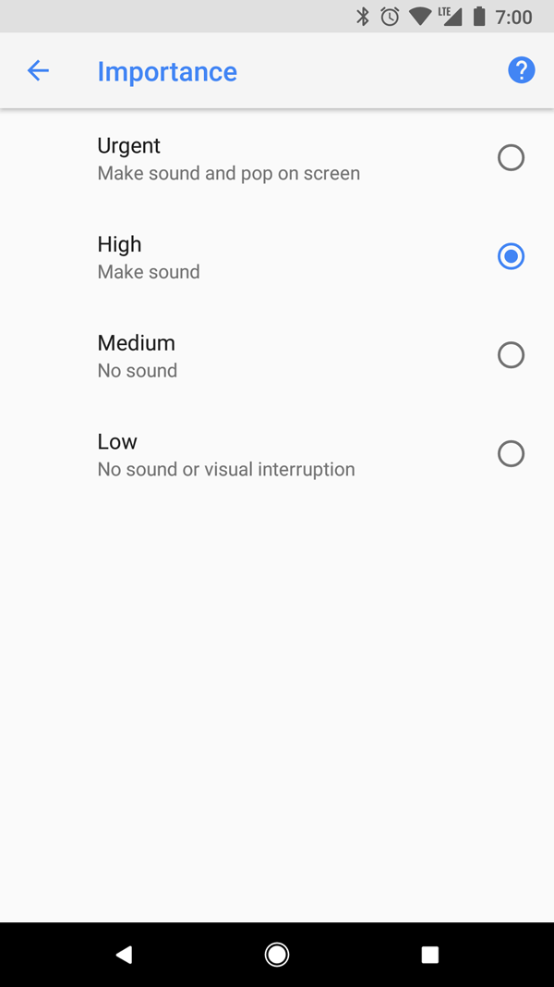
The possible importance levels are the following:
Urgent: Makes a sound and appears as a heads-up notification.
High: Makes a sound.
Medium: No sound.
Low: No sound and does not appear in the status bar.
All notifications, regardless of importance, appear in non-interruptive system UI locations, such as in the notification drawer and as a badge on the launcher icon (though you can modify the appearance of the notification badge.
Users can change the importance of each channel on Android 8.0 and higher

Slide 17
Do Not Disturb mode
Starting in Android 5.0 (API level 21), users can enable Do Not Disturb mode, which silences sounds and vibration for all notifications. Notifications still appear in the system UI as normal, unless the user specifies otherwise.
There are three different levels available in Do Not Disturb mode:
Total silence: blocks all sounds and vibrations, including from alarms, music, videos, and games.
Alarms only: blocks all sounds and vibrations, except from alarms.
Priority only: users can configure which system-wide categories can interrupt them (such as only alarms, reminders, events, calls, or messages). For messages and calls, users can also choose to filter based on who the sender or caller is (figure 13).

Slide 18
Posting limits
Beginning with Android 8.1 (API level 27), apps cannot make a notification sound more than once per second. If your app posts multiple notifications in one second, they all appear as expected, but only the first notification per second makes a sound.
However, Android also applies a rate limit when updating a notification. If you post updates to a single notification too frequently (many in less than one second), the system might drop some updates.

Slide 19
Push Notification

Slide 20
How Push Works I (Register device for Push)
Ask system to generate token (user confirms or not)
Device ask Google for token (register device for that token)
Google send back that token
System provides token to developer

Slide 21
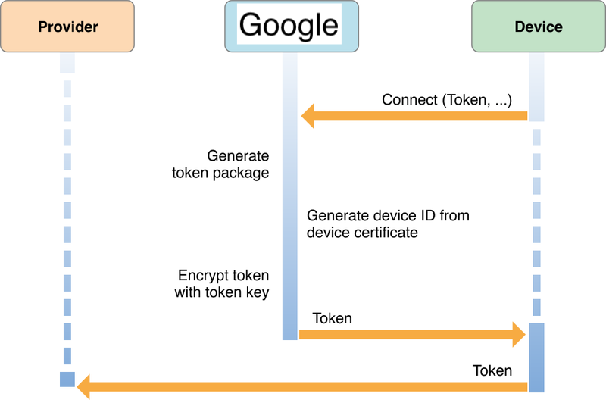

Slide 22
How Push Works II (Send push to device)
If you use provider like firebase, onesignal and etc (most likely you do)
1) You compose on backend message (data and token) and send it to provider
2) Provider would deliver it to a phone by composing a valid request to a Google services

Slide 23
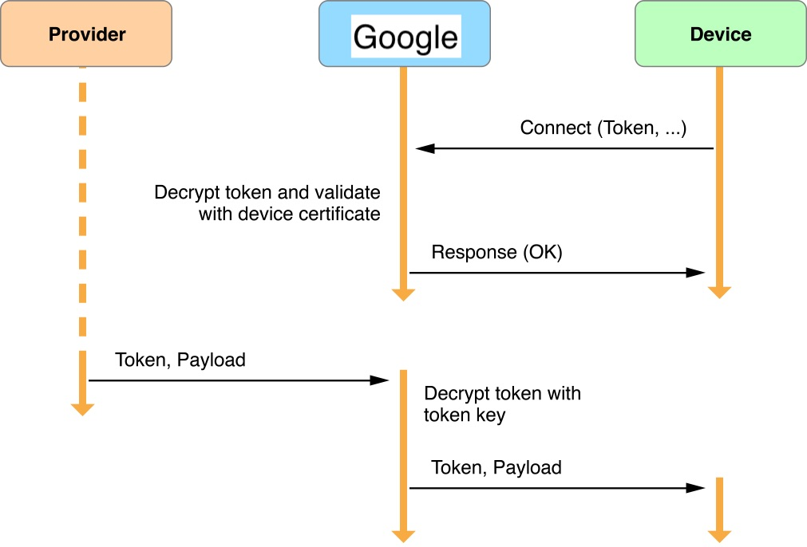

Slide 24
Push notification providers
https://firebase.google.com/docs/cloud-messaging/
https://onesignal.com/

Slide 25
Homework
Add Local notification to app (Lesson 8 or your version) that would pop up after 24h from first app opening with message “Its time to look at new inspiring images!”
Add Push notification to app (via one signal) and send at least 1!
Note: on emulator you should have Google services and login via email on it
Extra: add pagination to Unsplash like its done in Giphy (load items when end reach)
https://unsplash.com/documentation#pagination - tutorials
https://api.unsplash.com/photos/?page=2&per_page=30&client_id - example on how it would look like

